Slide 1
24-bit Audio CODEC
數位電路實驗
TA: 吳柏辰
Author: Trumen

Slide 2
Outline
Introduction to Audio Signal
Architecture Overview
Device Initialization
Device Operation

Slide 3
Introduction to Audio Signal

Slide 4
Introduction
An audio signal = electrical voltage.
Headphones convert electrical signals into sound.
Microphones convert sound into electrical signals.
Audio signals have frequencies in the audio frequency range of roughly 20 to 20,000 Hz.

Slide 5
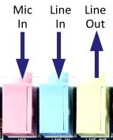
Line In V.S. Mic In
Line input/output: 0.3 to 2 Volts.
Microphone input: 5 to 50 mV.
ADC is required to convert Voltage to 00101010

Slide 6
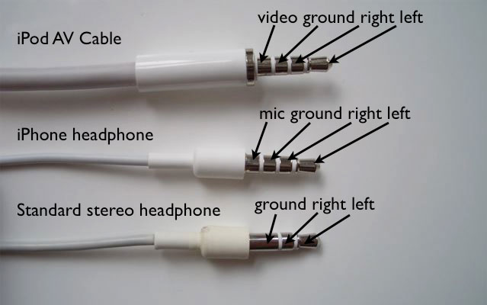
Dual Channel
http://appleinsider.com/articles/09/02/12/macbook_owners_frustrated_by_new_audio_jacks

Slide 7
Architecture Overview

Slide 8
DE2_115_User_manual\DE2_115_User_manual.pdf

Slide 9
Schematic Diagram
DE2_115_User_manual\DE2_115_User_manual.pdf

Slide 10
Audio CODEC Pin Assignments
DE2_115_User_manual\DE2_115_User_manual.pdf
Signal Name | FPGA Pin No. | Description
I2C_SCLK | PIN_B7 | I2C Clock
I2C_SDAT | PIN_A8 | I2C Data
AUD_XCK | PIN_E1 | Audio CODEC Chip Clock
AUD_BCLK | PIN_F2 | Audio CODEC Bit-Steam Clock
AUD_ADCLRCK | PIN_C2 | Audio CODEC ADC LR Clock
AUD_ADCDAT | PIN_D2 | Audio CODEC ADC Data
AUD_DACLRCK | PIN_E3 | Audio CODEC DAC LR Clock
AUD_DACDAT | PIN_D1 | Audio CODEC DAC Data
Control
Data

Slide 11
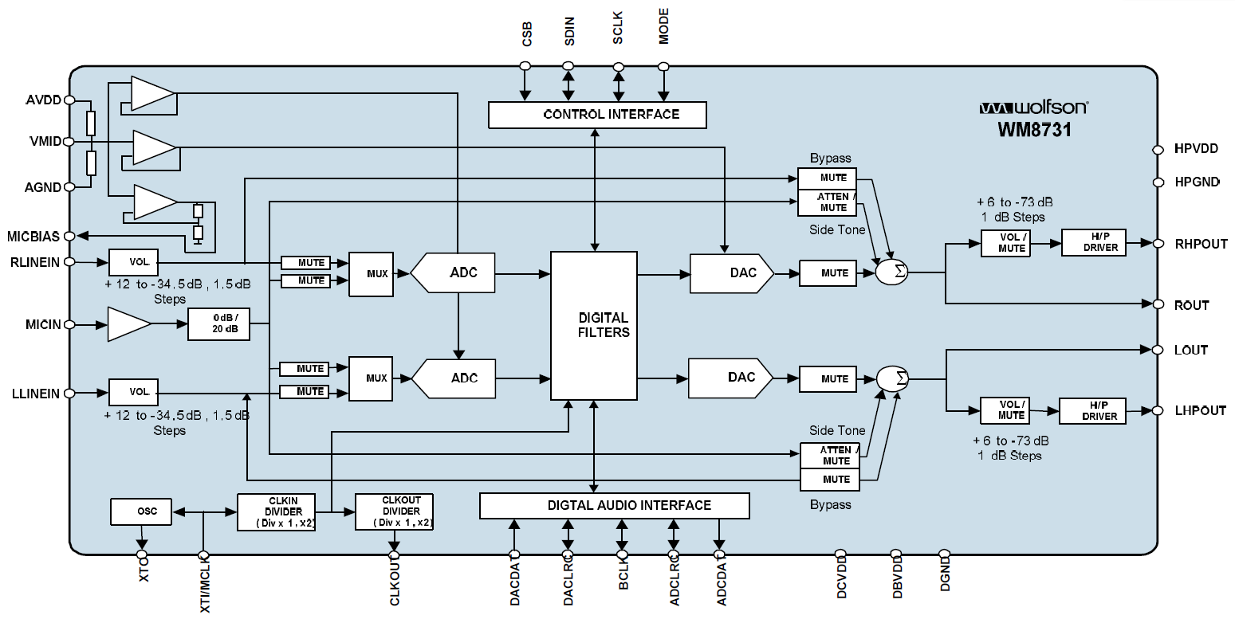
WM8731 Block Diagram
DE2_115_datasheets\Audio CODEC\WM8731.pdf

Slide 12
How to Use WM8731?
Initialize the device by setting the registers via I2C bus interface.
After correct initialization, we can receive or transmit audio data via digital audio interface.

Slide 13
Device Initialization

Slide 14
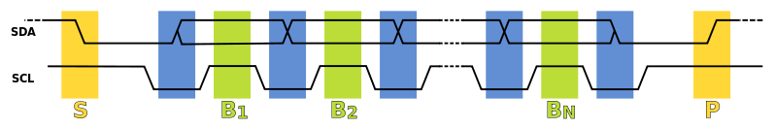
I²C Protocol (1/4)
Data transfer in initiated with the START bit (S) when SDA is pulled low while SCL stays high.
Then, SDA sets the transferred bit while SCL is low (blue) and the data is sampled (received) when SCL rises (green).
SDA=1'b0

Slide 15
I²C Protocol (2/4)
When the transfer is complete, a STOP bit (P) is sent by releasing the data line to allow it to be pulled up while SCL is constantly high.
In order to avoid false marker detection, the level on SDA is changed on the falling edge and is captured on the rising edge of SCL.
SDA=1'b1 or SDA=1'bz

Slide 16
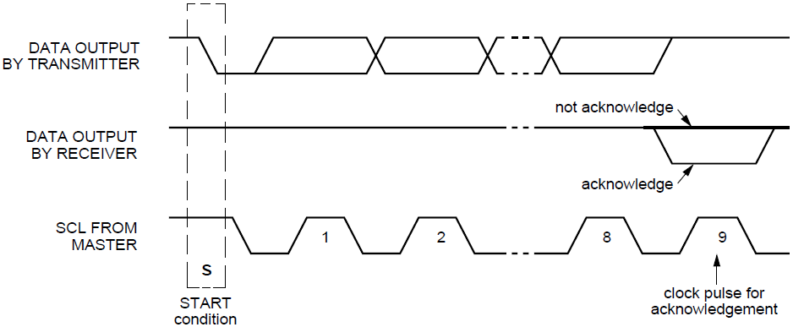
I²C Protocol (3/4)
After every 8 data bits in one direction, an "acknowledge" bit (0) is transmitted in the other direction.

Slide 17
I²C Protocol (4/4)
Inout port example:
input in_dat;
input clk;
input out_enable;
output logic out_r;
logic out_w;
assign out_dat = out_enable ? out_r : 1’bz;
always_ff @(posedge clk) begin
out_r <= in_dat;
end

Slide 18
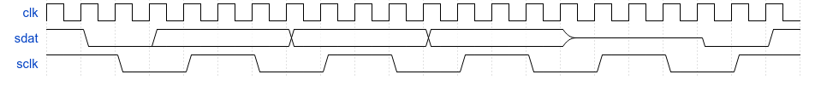
Workable I²C Protocol
4/cycle bit, 1 ack bit/byte
3+3 cycles header
#Cycles is required for N-Bytes?
(This is not the full specification.)

Slide 19
Software Control Interface (1/2)
Different modes can be configured under software control.
Input to ADC: Microphone
Sampling rate: 32kHz
Input audio data bit length: 16 bits
etc.

Slide 20
2-Wire Serial Control Mode
The WM8731/L supports a 2-wire MPU (Microprocessor unit) interface, which is compatible with I²C protocol.
I²C (Inter-Integrated Circuit, referred to as I-squared-C) uses only two bidirectional open-drain lines, Serial Data Line (SDA) and Serial Clock (SCL).

Slide 21
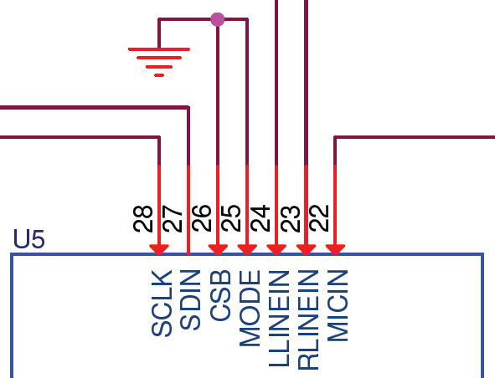
2-Wire Interface (1/2)
The device operates as a slave device only.
The WM8731/L has one of two slave address that are selected by setting the state of the CSB pin.
CSB STATE | ADDRESS
0 | 0011010
1 | 0011011

Slide 22
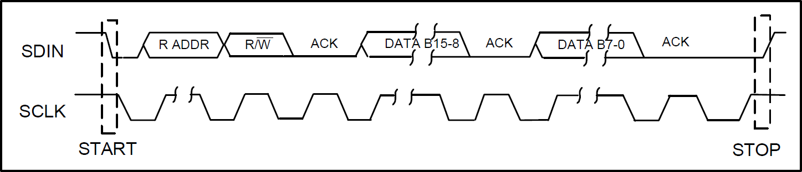
2-Wire Interface (2/2)
2-wire serial interface
ADDR[6:0] (7 bits) are Slave Address Bits
R/W is '0', indicating a write
B[15:9] (7 bits) are Register Address Bits
B[8:0] (9 bits) are Register Data Bits
0011010
0
Max freq. = 526 kHz

Slide 23
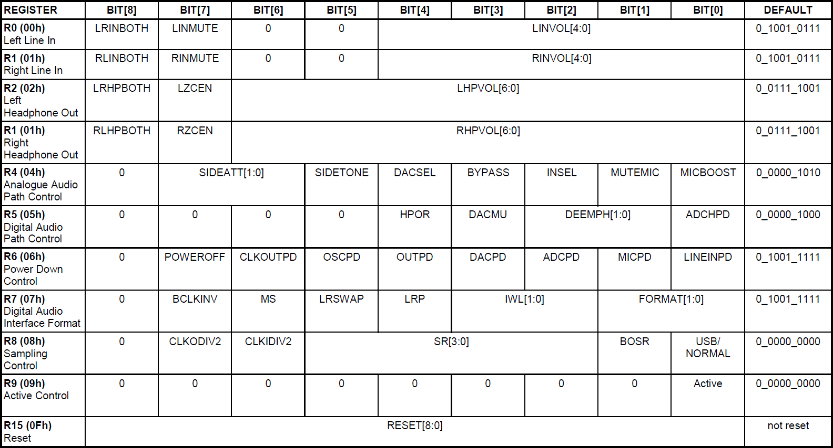
Register Map
Check the WM8731/L document to see the details.

Slide 24
Digital Audio Interfaces
WM8731/L may be operated in either one of the 4 offered audio interface modes. These are:
Right justified
Left justified
I²S
DSP mode

Slide 25
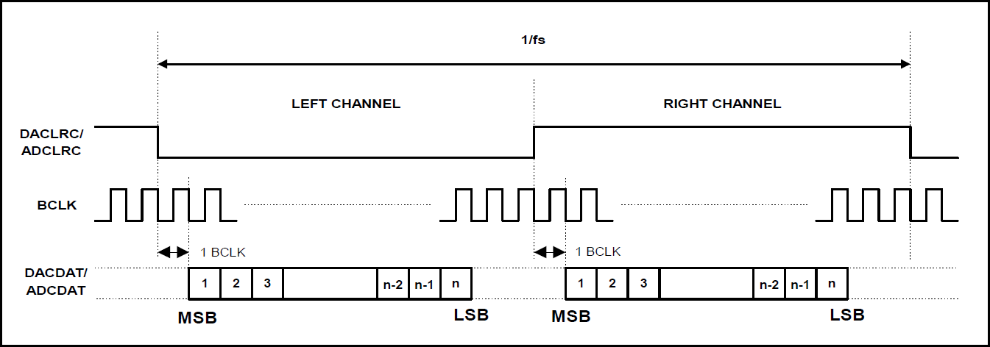
Digital Audio Interface Format
I²S format

Slide 26
Digital Audio Interfaces
The length of the digital audio data is programmable at 16/20/24 or 32 bits.
The data is signed 2's complement.
-32768~32767
logic signed [15:0] dat;

Slide 27
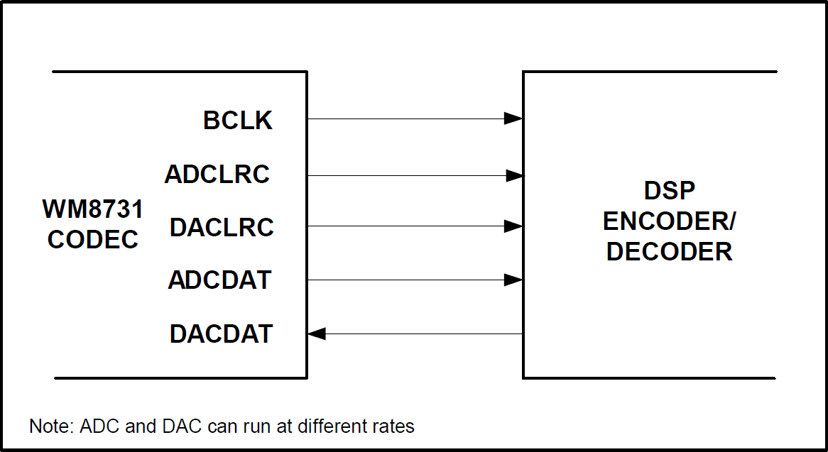
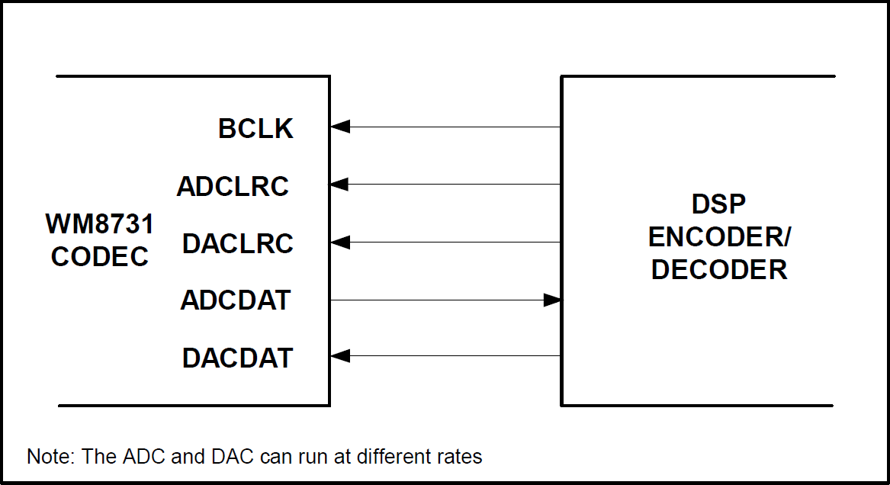
Digital Audio Interface Format
Master mode v.s. Slave mode

Slide 28
Digital Audio Interface Format (1/2)
Choose I²S format, 16-bit length, and master mode.
000_0111_0_0100_0010
REGISTER | BIT[8] | BIT[7] | BIT[6] | BIT[5] | BIT[4] | BIT[3] | BIT[2] | BIT[1] | BIT[0] | DEFAULT
R7 (07h) Digital Audio Interface Format | 0 | BCLKIVE | MS | LRSWAP | LRP | IWL[[1:0] |  | FORMAT[1:0] |  | 0_0000_1010

Slide 29
Recommended I²C Settings
Left Line In | 000_0000_0_1001_0111
Right Line In | 000_0001_0_1001_0111
Left Headphone Out | 000_0010_0_0111_1001
Right Headphone Out | 000_0011_0_0111_1001
Analogue Audio Path Control | 000_0100_0_0001_0101
Digital Audio Path Control | 000_0101_0_0000_0000
Power Down Control | 000_0110_0_0000_0000
Digital Audio Interface Format | 000_0111_0_0100_0010
Sampling Control | 000_1000_0_0001_1001
Active Control | 000_1001_0_0000_0001

Slide 30
The End.
Any question?

Slide 31
Reference
http://en.wikipedia.org/wiki/Audio_signal
http://en.wikipedia.org/wiki/I%C2%B2C
"THE I 2C-BUS SPECIFICATION VERSION 2.1" by Philips.
"DE2-115 User Manual" by Terasic.
"DE2-115_MB.pdf" by Terasic.
"WM8731.pdf" by Wolfson Microelectronics.

Slide 32
Appendix

Slide 33
Left Line In
Just use the default setting if we do not use the line input.
000_0000_0_1001_0111
REGISTER | BIT[8] | BIT[7] | BIT[6] | BIT[5] | BIT[4] | BIT[3] | BIT[2] | BIT[1] | BIT[0] | DEFAULT
R0 (00h) Left Line In | LRINBOTH | LINMUTE | 0 | 0 | LINVOL[4:0] |  |  |  |  | 0_1001_0111

Slide 34
Right Line In
Just use the default setting if we do not use the line input.
000_0001_0_1001_0111
REGISTER | BIT[8] | BIT[7] | BIT[6] | BIT[5] | BIT[4] | BIT[3] | BIT[2] | BIT[1] | BIT[0] | DEFAULT
R1 (01h) Right Line In | RLINBOTH | RINMUTE | 0 | 0 | RINVOL[4:0] |  |  |  |  | 0_1001_0111

Slide 35
Left Headphone Out
Here we can just use the default setting.
000_0010_0_0111_1001
REGISTER | BIT[8] | BIT[7] | BIT[6] | BIT[5] | BIT[4] | BIT[3] | BIT[2] | BIT[1] | BIT[0] | DEFAULT
R2 (02h) Left Headphone Out | LRHPBOTH | LZCEN | LHPVOL[6:0] |  |  |  |  |  |  | 0_0111_1001

Slide 36
Right Headphone Out
Here we can just use the default setting.
000_0011_0_0111_1001
REGISTER | BIT[8] | BIT[7] | BIT[6] | BIT[5] | BIT[4] | BIT[3] | BIT[2] | BIT[1] | BIT[0] | DEFAULT
R3 (03h) Right Headphone Out | RLHPBOTH | RZCEN | RHPVOL[6:0] |  |  |  |  |  |  | 0_0111_1001

Slide 37
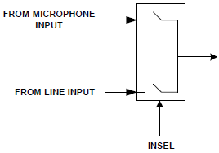
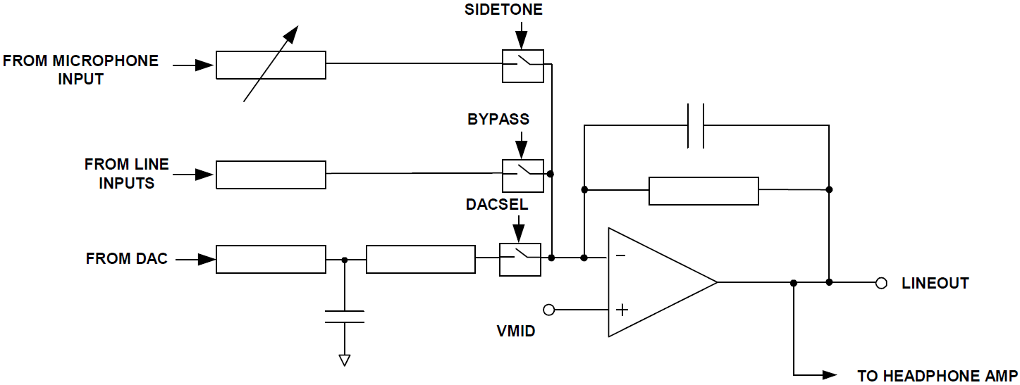
Analogue Audio Path Control
Enable boost, disable mute, choose microphone input, disable bypass, and select DAC.
000_0100_0_0001_0101
REGISTER | BIT[8] | BIT[7] | BIT[6] | BIT[5] | BIT[4] | BIT[3] | BIT[2] | BIT[1] | BIT[0] | DEFAULT
R4 (04h) Analogue Audio Path Control | 0 | SIDEATT[1:0] |  | SIDETONE | DACSEL | BYPASS | INSEL | MUTEMIC | MICBOOST | 0_0000_1010

Slide 38
Digital Audio Path Control
Disable soft mute
000_0101_0_0000_0000
REGISTER | BIT[8] | BIT[7] | BIT[6] | BIT[5] | BIT[4] | BIT[3] | BIT[2] | BIT[1] | BIT[0] | DEFAULT
R5 (05h) Digital Audio Path Control | 0 | 0 | 0 | 0 | HPOR | DACMU | DEEMPH[1:0] |  | ADCHPD | 0_0000_1000

Slide 39
Power Down Control
Choose power on and disable all the power down options.
000_0110_0_0000_0000
REGISTER | BIT[8] | BIT[7] | BIT[6] | BIT[5] | BIT[4] | BIT[3] | BIT[2] | BIT[1] | BIT[0] | DEFAULT
R6 (06h) Power Down Control | 0 | POWER OFF | CLKOUTPD | OSCPD | OUTPD | DACPD | ADCPD | MICPD | LINEINPD | 0_1001_1111

Slide 40
Digital Audio Interface Format (1/2)
Choose I²S format, 16-bit length, and master mode.
000_0111_0_0100_0010
REGISTER | BIT[8] | BIT[7] | BIT[6] | BIT[5] | BIT[4] | BIT[3] | BIT[2] | BIT[1] | BIT[0] | DEFAULT
R7 (07h) Digital Audio Interface Format | 0 | BCLKIVE | MS | LRSWAP | LRP | IWL[[1:0] |  | FORMAT[1:0] |  | 0_0000_1010

Slide 41
Digital Audio Interface Format (2/2)
I²S format
Master mode v.s. Slave mode
16-bit length

Slide 42
Sampling Control (1/2)
Choose USB mode (fixed MCLK 12MHz) and sampling rate = 32 kHz.
000_1000_0_0001_1001
REGISTER | BIT[8] | BIT[7] | BIT[6] | BIT[5] | BIT[4] | BIT[3] | BIT[2] | BIT[1] | BIT[0] | DEFAULT
R8 (08h) Sampling Control | 0 | CLKODIV2 | CLKIDIV2 | SR[3:0] |  |  |  | BOSR | USB/ Normal | 0_0000_0000

Slide 43
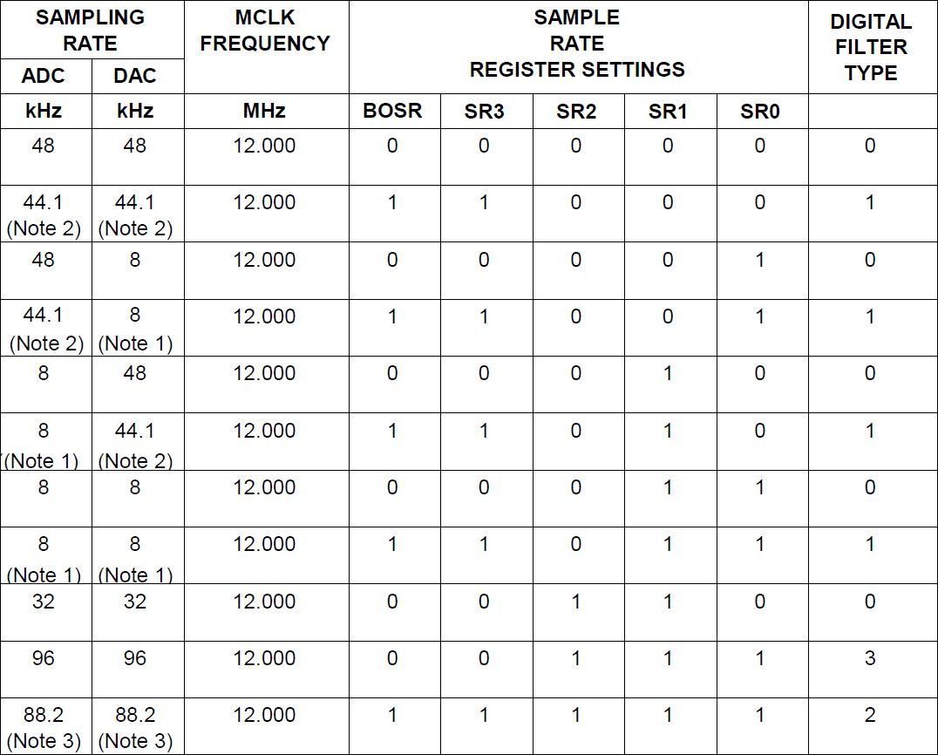
Sampling Control (2/2)

Slide 44
Active Control
Activate interface
000_1001_0_0000_0001
REGISTER | BIT[8] | BIT[7] | BIT[6] | BIT[5] | BIT[4] | BIT[3] | BIT[2] | BIT[1] | BIT[0] | DEFAULT
R9 (09h) Active Control | 0 | 0 | 0 | 0 | 0 | 0 | 0 | 0 | Active | 0_0000_0000

Slide 45
Reset Register
You can try to reset the device to a known (?) state.
000_1111_0_0000_0000 (?)
REGISTER | BIT[8] | BIT[7] | BIT[6] | BIT[5] | BIT[4] | BIT[3] | BIT[2] | BIT[1] | BIT[0] | DEFAULT
R15 (15h) Active Control | RESET[8:0] |  |  |  |  |  |  |  |  | not reset

